Slide 1

Syracuse University
Project Portfolio
Mackenzie Houser
M.S. Applied Data Science
March 2024

Slide 2
Learning Goals
Collect, store, and access data by identifying and leveraging applicable technologies.
Create actionable insight across a range of contexts using data and the full data science life cycle.
Apply visualization and predictive models to help generate actionable insight.
Use programming languages such as R and Python to support the generation of actionable insight.
Communicate insights gained via visualization and analytics to a broad range of audiences.
Apply ethics in the development, use and evaluation of data and predictive models.

Slide 3
Projects Overview
 | Class | Assignment | Individual/Group | Program | Learning Objective(s)
One | IST 718 | Lab | Individual | Python | 1, 2, 3, 4, 6
Two | IST 707 | Student Grade Prediction | Group | R-Studio | 1, 2, 3, 4, 5, 6
Three | IST 659 | Whole-ER Foods | Group | SQL | 1, 5, 6
Four | MBC 638 | Process Improvement | Individual | Microsoft Excel | 1, 2, 3, 5, 6

Slide 4
Project One
Learning Objective One
Learning Objective Two
Learning Objective Three
Learning Objective Four
Learning Objective Six

Slide 5
Project One
Learning Objective One
Collect: CSV file provided
Store: PC in JupyterNotebook
Access: Read in with pandas package

Slide 6

Project One
Learning Objective One
Learning Objective Two
Learning Objective Three
Learning Objective Four
Learning Objective Six

Slide 7
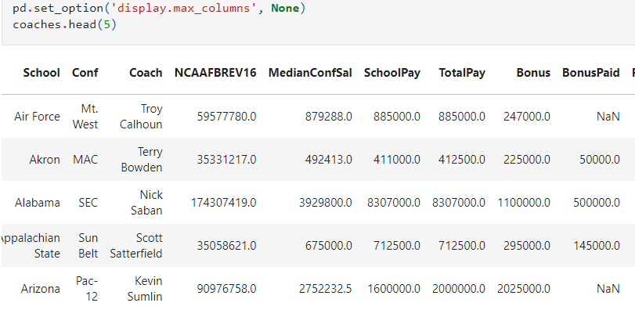
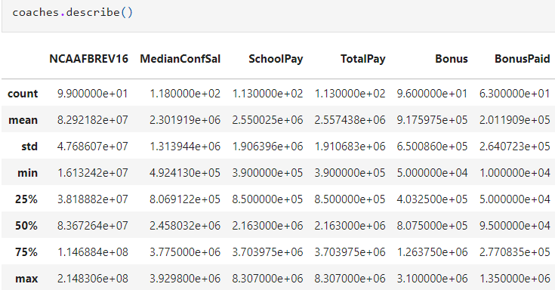
Project One
Learning Objective Two
Understand

Slide 8
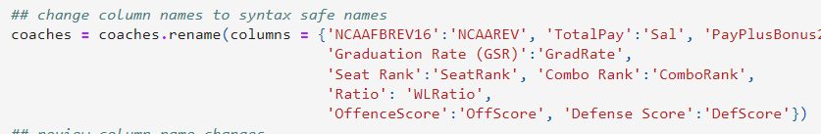
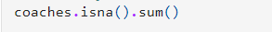

Project One
Learning Objective Two
Scrub

Slide 9
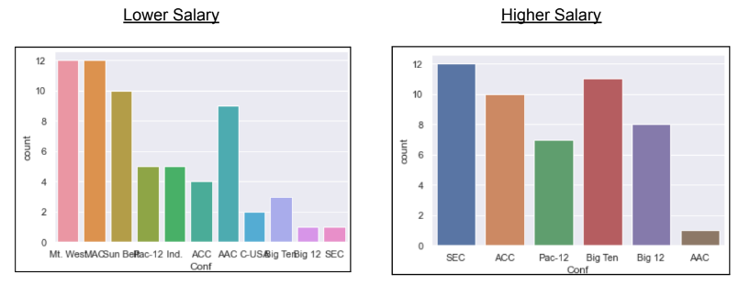
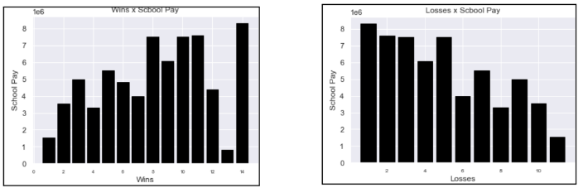
Project One
Learning Objective Two
Exploration

Slide 10
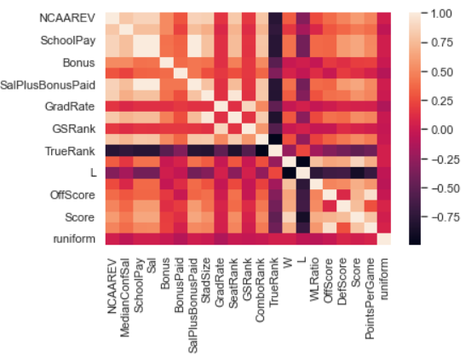
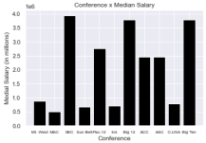
Project One
Learning Objective Two
Exploration Continued

Slide 11
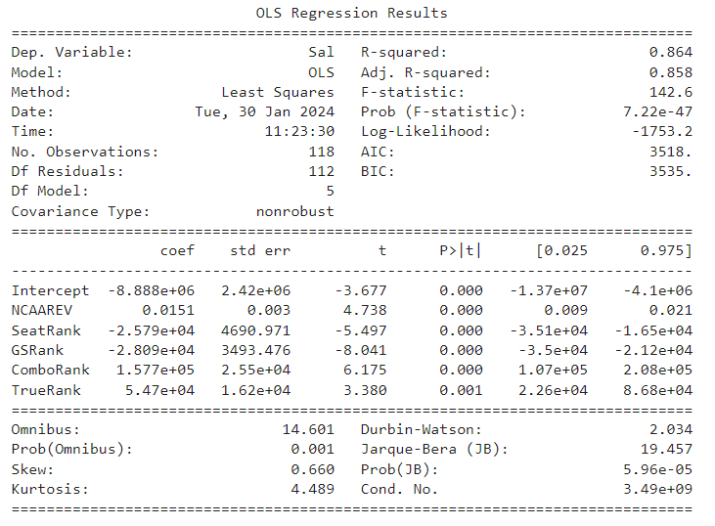
Project One
Learning Objective Two
Model

Slide 12
Project One
Learning Objective Two
Model
Interpret
Recommended salary for the Syracuse football coach?
Formula:
-8.888e+06 + 0.0151*(8.292182e+07) - 2.579e+04*(63) - 2.809e+04*(87) + 1.577e+05*(73.333333) + 5.47e+04*(49)
Answer:
$2,540,486.096

Slide 13
Project One
Learning Objective One
Learning Objective Two
Learning Objective Three
Learning Objective Four
Learning Objective Six

Slide 14
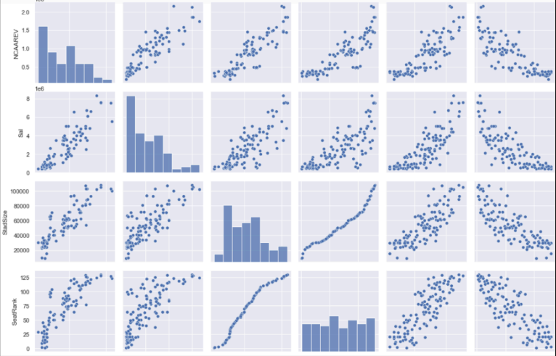
Project One
Learning Objective Three
Visualization & Predictive Model

Slide 15
Project One
Learning Objective One
Learning Objective Two
Learning Objective Three
Learning Objective Four
Learning Objective Six

Slide 16
Project One
Learning Objective Four
Python
Data Science Life Cycle
Key Insights
Data Analysis
Visualizations
Modeling
Pros
Open Source
Data Handling
Extensive Libraries
Cons
Database Access
Slow Speed
Weak Memory

Slide 17
Project One
Learning Objective One
Learning Objective Two
Learning Objective Three
Learning Objective Four
Learning Objective Six

Slide 18
Project One
Learning Objective Six
Ethics CFB
Bias
Fairness
Politics

Slide 19
Project One
Learning Objective One
Learning Objective Two
Learning Objective Three
Learning Objective Four
Learning Objective Six

Slide 20
Project Two
Learning Objective One
Learning Objective Two
Learning Objective Three
Learning Objective Four
Learning Objective Five
Learning Objective Six

Slide 21
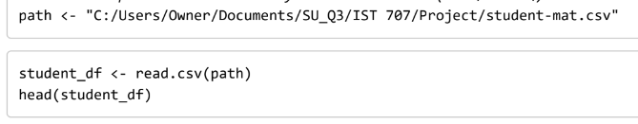
Project Two
Learning Objective One
Collect: Kaggle
Store: PC
Access: Read into R-Studio RMD using read.csv

Slide 22
Project Two
Learning Objective One
Learning Objective Two
Learning Objective Three
Learning Objective Four
Learning Objective Five
Learning Objective Six

Slide 23
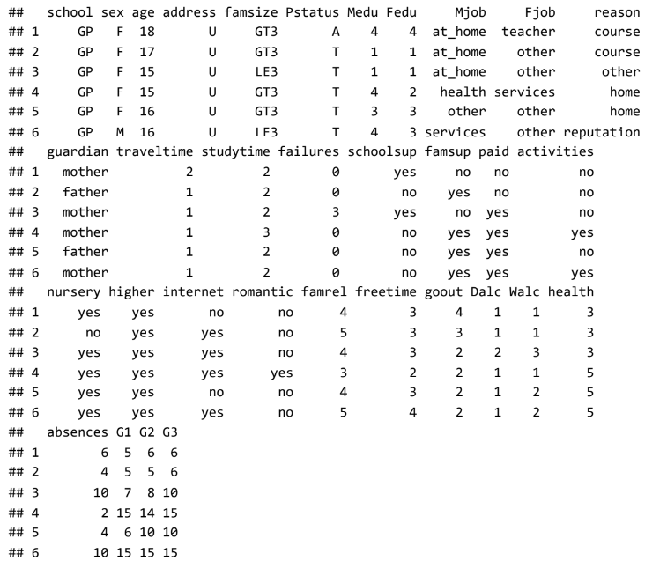
Project Two
Learning Objective Two
Business Understanding
Identifying students who struggle and adapting accordingly will benefit reputation of the school(s)
Historical data allows schools to identify trends and adjust
Increase in grades leads to better students and a better school
Data Understanding

Slide 24
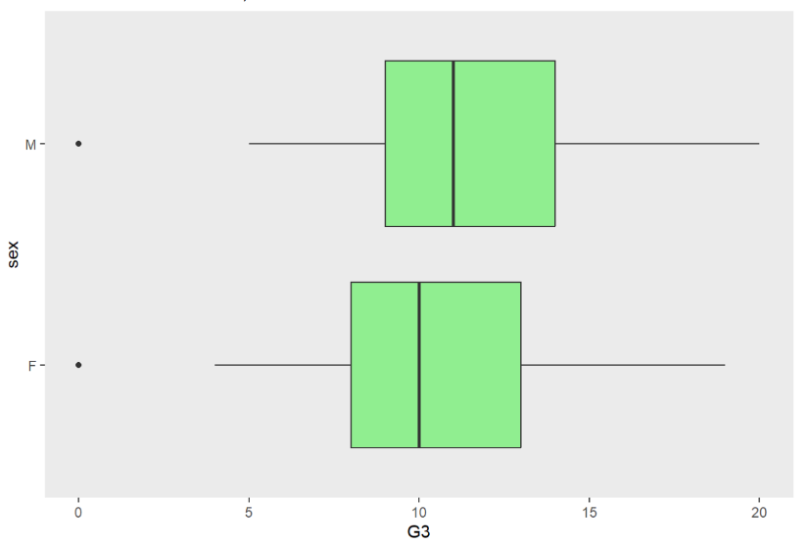
Project Two
Learning Objective Two
Scrub
Notes:
Some outliers were found, but in this case that is okay since the focus is on those students with failing grades.

Slide 25
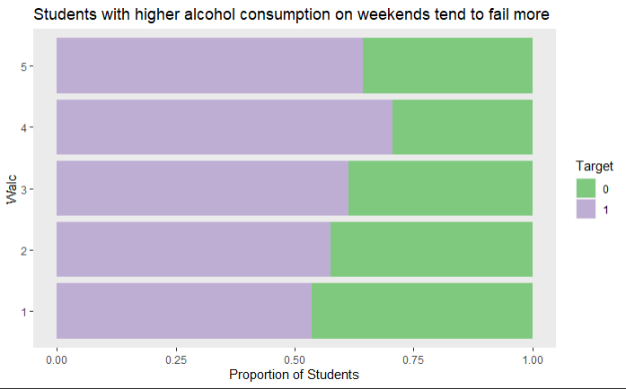
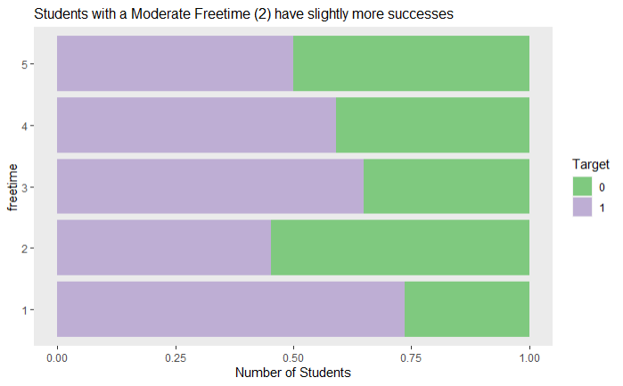
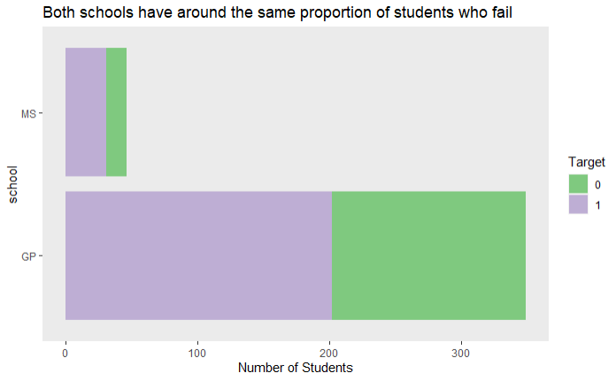
Project Two
Learning Objective Two
Exploration

Slide 26
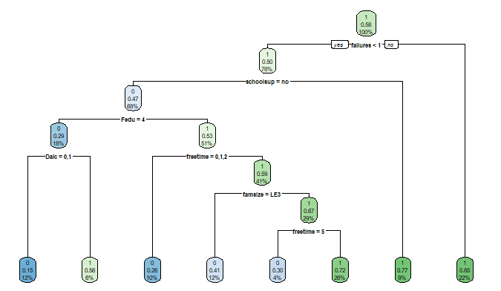
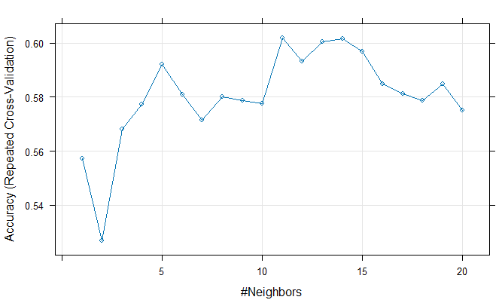
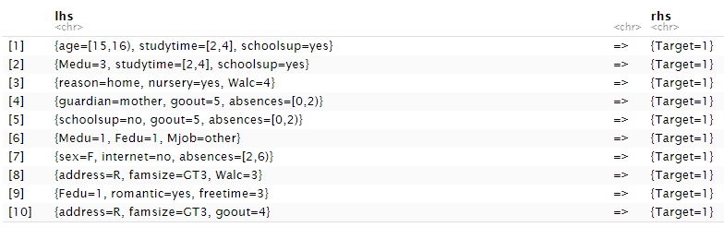
Project Two
Learning Objective Two
Model

Slide 27
Project Two
Learning Objective Two
Interpret
Model | Accuracy
No Information Rate | .5897
Decision Tree | .7464
Logistic Regression | .7174
kNN | .6884
SVM | .8188
Random Forest | .9928

Slide 28
Project Two
Learning Objective One
Learning Objective Two
Learning Objective Three
Learning Objective Four
Learning Objective Five
Learning Objective Six

Slide 29
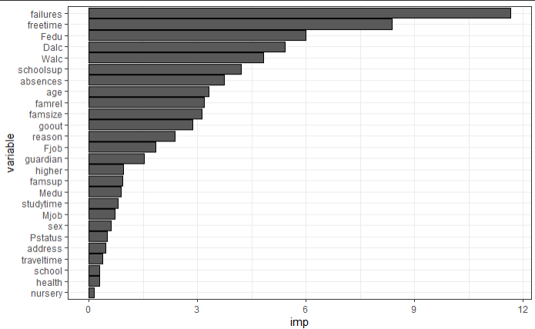
Project Two
Learning Objective Three
Interpret
Model | Accuracy
No Information Rate | .5897
Decision Tree | .7464
Logistic Regression | .7174
kNN | .6884
SVM | .8188
Random Forest | .9928

Slide 30
Project Two
Learning Objective One
Learning Objective Two
Learning Objective Three
Learning Objective Four
Learning Objective Five
Learning Objective Six

Slide 31
Project Two
Learning Objective Four
R-Studio / R
Data Science Life Cycle
Key Insights
Data Analysis
Visualizations
Modeling
Pros
Open Source
Strong Graphics
Array of Packages / Functions
Cons
Slow Speed
Weak Security
Data Handling

Slide 32
Project Two
Learning Objective One
Learning Objective Two
Learning Objective Three
Learning Objective Four
Learning Objective Five
Learning Objective Six

Slide 33
Project Two
Learning Objective Five
PowerPoint Presentation
Box Plots
Bar Chart
kNN Plot
Tree Model
Accuracy Values
Notes:
When communicating with a broad range of audiences, it is best to capture everything in a presentation. Projects two, three, and four all required to communicate findings in presentation format. Presentations want to be understandable by all. This means taking data scientific findings and presenting them in a way different backgrounds understand. Visualizations are often a universal form of communication.

Slide 34
Project Two
Learning Objective One
Learning Objective Two
Learning Objective Three
Learning Objective Four
Learning Objective Five
Learning Objective Six

Slide 35
Project Two
Learning Objective Six
Ethics
Student Perspective
Personal Knowledge
Social Norms

Slide 36
Project Two
Learning Objective One
Learning Objective Two
Learning Objective Three
Learning Objective Four
Learning Objective Five
Learning Objective Six

Slide 37
Project Three
Learning Objective One
Learning Objective Five
Learning Objective Six

Slide 38
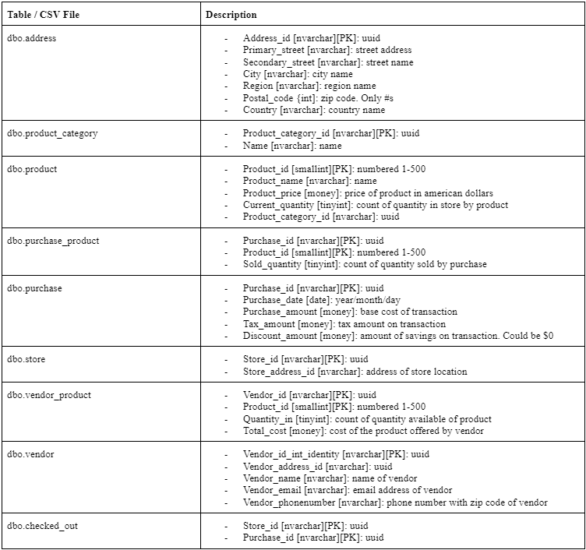
Project Three
Learning Objective One
Collect

Slide 39
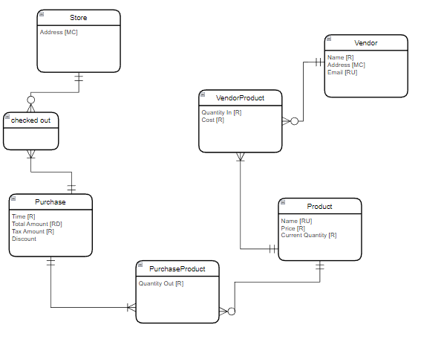
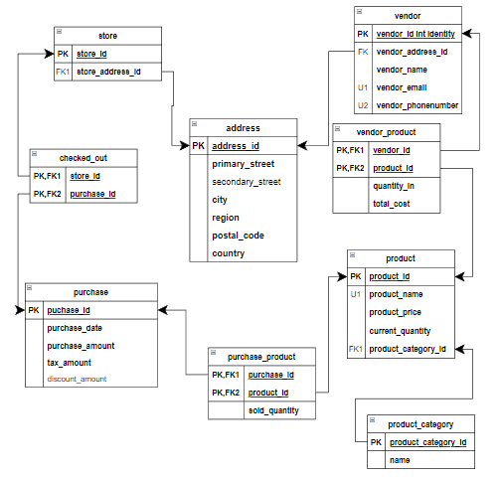
Project Three
Learning Objective One
Conceptual Data Model
Logical Data Model

Slide 40
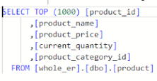
Project Three
Learning Objective One
Access

Slide 41
Project Three
Learning Objective One
Learning Objective Five
Learning Objective Six

Slide 42
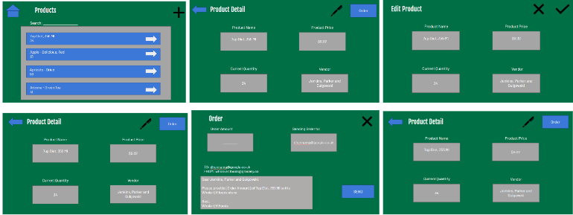
Project Three
Learning Objective Five
PowerPoint Presentation
Beautified Mockup
Notes:
When communicating with a broad range of audiences, it is best to capture everything in a presentation. Projects two, three, and four all required to communicate findings in presentation format. Presentations want to be understandable by all. This means taking data scientific findings and presenting them in a way different backgrounds understand. Visualizations are often a universal form of communication.

Slide 43
Project Three
Learning Objective One
Learning Objective Five
Learning Objective Six

Slide 44
Project Three
Learning Objective Six
Ethics
Product Life Cycle
Accountability
Responsibility
Relationships

Slide 45
Project Three
Learning Objective One
Learning Objective Five
Learning Objective Six

Slide 46
Project Four
Learning Objective One
Learning Objective Two
Learning Objective Three
Learning Objective Five
Learning Objective Six

Slide 47
Project Four
Learning Objective One
Collect: Manually collected from iPhone - Phone Usage Setting
Store: Data recorded in Microsoft Excel
Access: Automatic since data was personally collected

Slide 48
Project Four
Learning Objective One
Learning Objective Two
Learning Objective Three
Learning Objective Five
Learning Objective Six

Slide 49
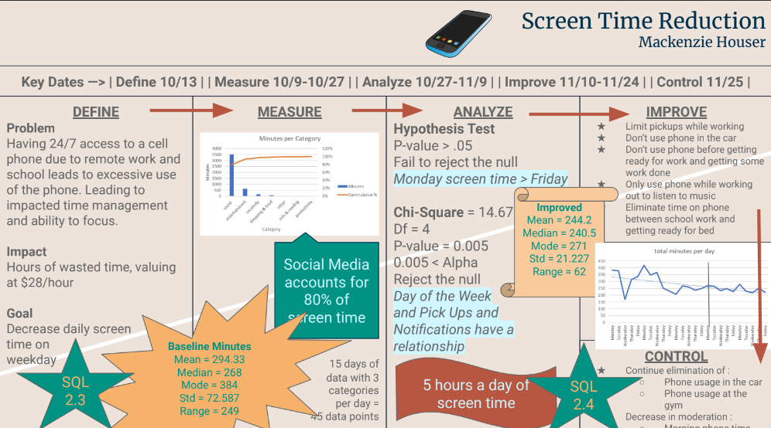

Slide 50
Project Four
Learning Objective One
Learning Objective Two
Learning Objective Three
Learning Objective Five
Learning Objective Six

Slide 51
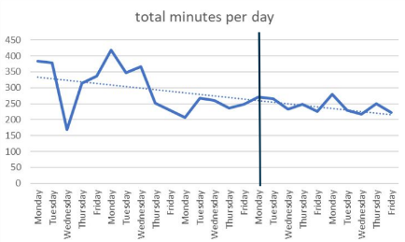
Project Four
Learning Objective Three

Slide 52
Project Four
Learning Objective One
Learning Objective Two
Learning Objective Three
Learning Objective Five
Learning Objective Six

Slide 53
Project Four
Learning Objective Five
PowerPoint Presentation
Simple Plots
Time Series
Basic Statistics
Null Hypothesis
Notes:
When communicating with a broad range of audiences, it is best to capture everything in a presentation. Projects two, three, and four all required to communicate findings in presentation format. Presentations want to be understandable by all. This means taking data scientific findings and presenting them in a way different backgrounds understand. Visualizations are often a universal form of communication.

Slide 54
Project Four
Learning Objective One
Learning Objective Two
Learning Objective Three
Learning Objective Five
Learning Objective Six

Slide 55
Project Four
Learning Objective Six
Ethics
Personal Behavior
Honesty
Integrity

Slide 56
Project Four
Learning Objective One
Learning Objective Two
Learning Objective Three
Learning Objective Five
Learning Objective Six

Slide 57
Strengths
Visualizations
Problem Solving
Identifying Issues

Slide 58
Challenges
Program to Program
Simplifying Code

Slide 59
Future Goals
Maintain Data Science Skills
Improve Data Science Skills
Professional Collaboration

Slide 60

Thank You

